Slide 1
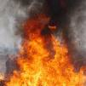
Injuries by Physical Agents Burns
Dr.Nirmala Perera
Department of Forensic Medicine
2016

Slide 2
Objectives
Identify different types of injuries caused by physical agents
Identify different circumstances of burn injuries
Identify medico legal issues related to burn injuries
Able to examine and prepare Medico legal report on a burnt patient (clinical appointment)

Slide 3

Injuries according to the causative factors
Mechanical injuries
Physical agents
Thermal
Chemical
Electrical
Lightening
Radiation
Blunt force trauma
Sharp force trauma

Slide 4
Heat injury
Body heat increases as a result of external application of heat affecting cellular structure and function.

Slide 5
Heat injuries
Moist heat
Dry heat
Flame
Scalds
Radiant heat
Contact heat
Electricity
Lightening

Slide 6
Severity and effects
The temperature of the heat source
Duration for which the heat was applied
Resistance of the body to withstand heat
Extent of body surface area
Area of the body
Age and sex of the victim

Slide 7
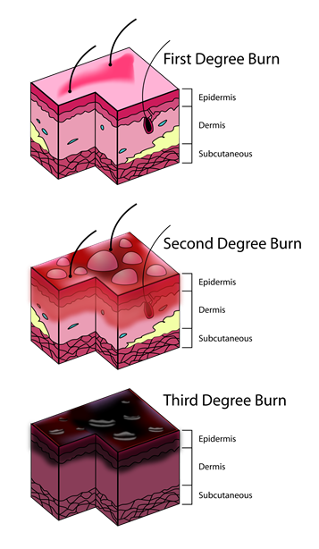
Classification of severity of burns
First degree – Erythema and blistering without loss of dermis.
Second degree – full thickness of the dermis is destructed.
Third degree – Destruction of deeper tissue below the skin.

Slide 8
Area of burns
‘rule of nine’ or
‘Lund and Browder’ charts.

Slide 9
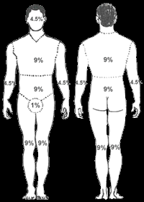
Rule of nine

Slide 10
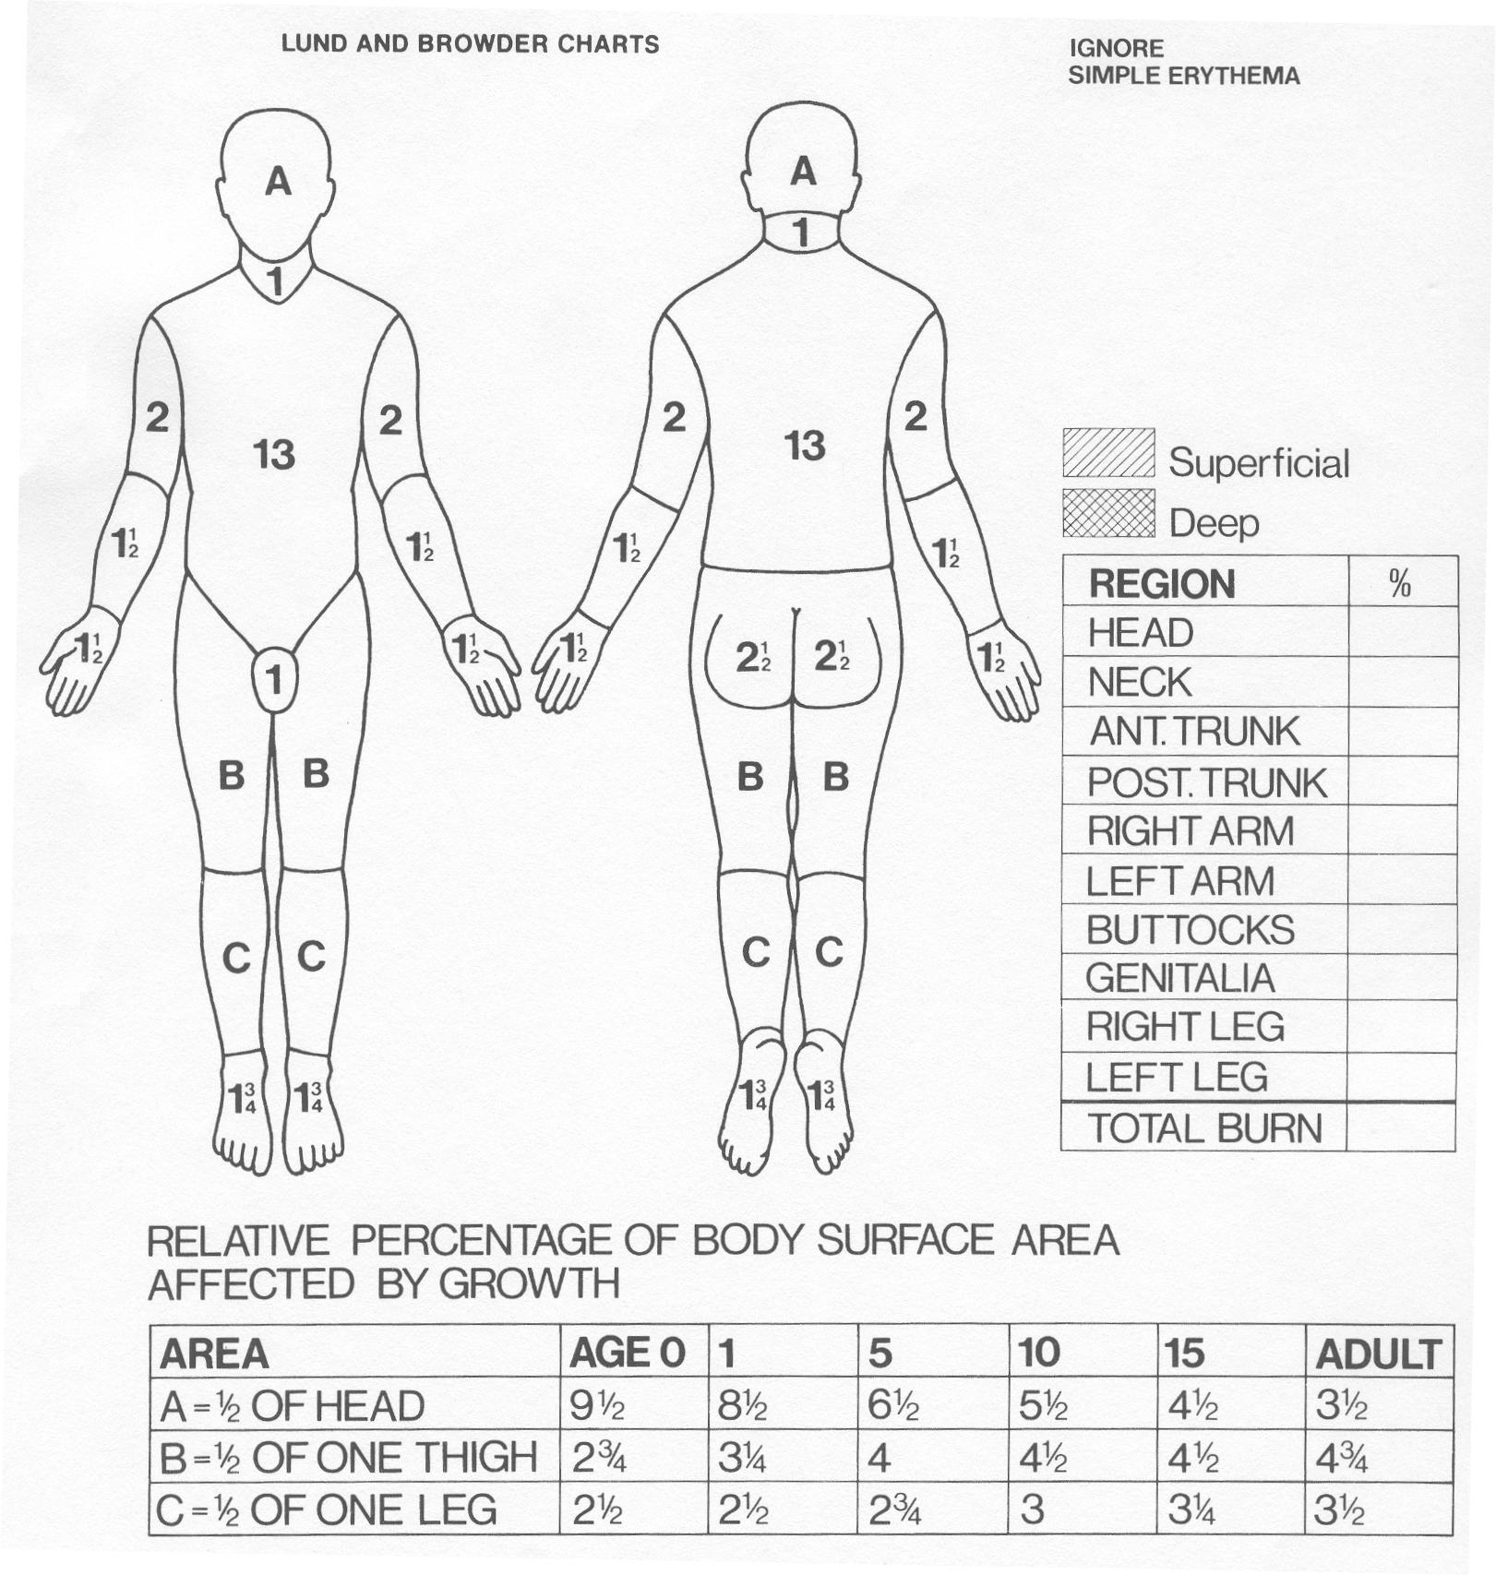
Lund and Browder

Slide 11
Types of burns
Scalds
Dry burns
Corrosive burns

Slide 12
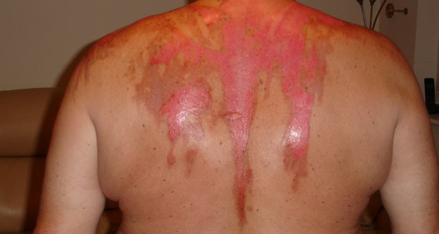
Moist thermal burns /Scalds
Moist burns are referred to as scalds
Temperature cools gradually as it disperse
Point of contact produce maximum damage

Slide 13
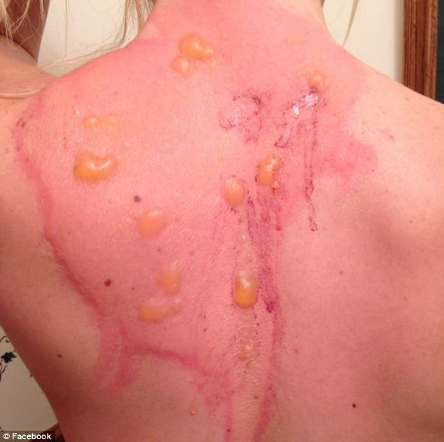
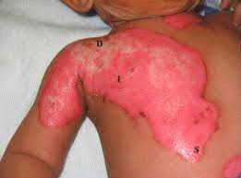
Appearance of scalds
Sodden bleached appearance
Erythema
Necrosis of dermis
Abundant blisters/vesicles

Slide 14
Appearance of scalds
Mostly over the clothed area
Splash marks
Drip marks
No singeing of hair

Slide 15
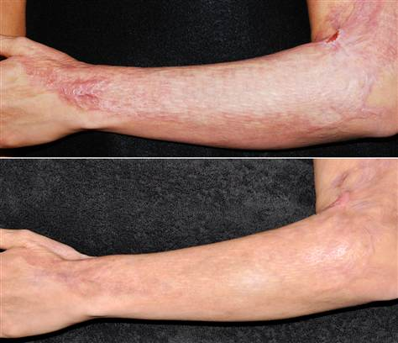
Appearance of scalds
No charring
Heal with out a scar except hot oil, molten metal & tar
minimal disfigurement

Slide 16
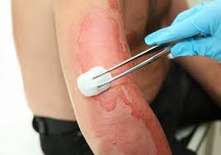
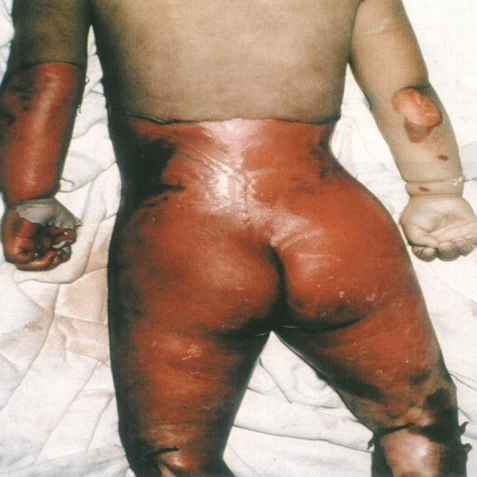
Circumstances of scalds
Accidental
children and in elderly
Intentional
child abuse, domestic violence
Dribble pattern and splash marks guide for circumstances

Slide 17
Burns from dry heat
They are caused by
flame
heated objects
Radiated heat

Slide 18
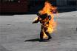
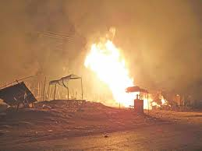
Circumstances
Mostly accidental
Bottle lamps
Kerosene cookers / LP gas
Alcoholics - Smoking
Suicidal
Kerosene oil

Slide 19
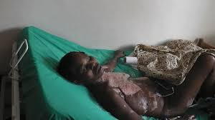
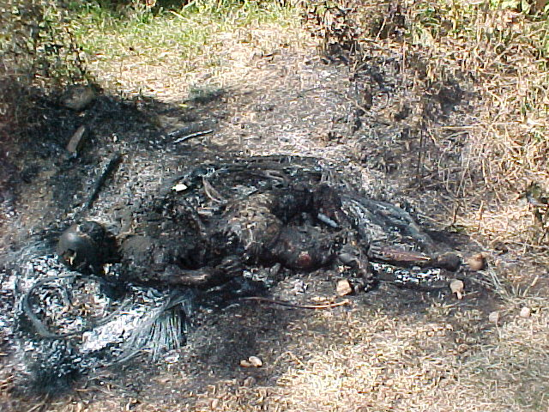
Circumstances
Rarely homicidal
Kerosene or petrol is used
Postmortem disposal

Slide 20
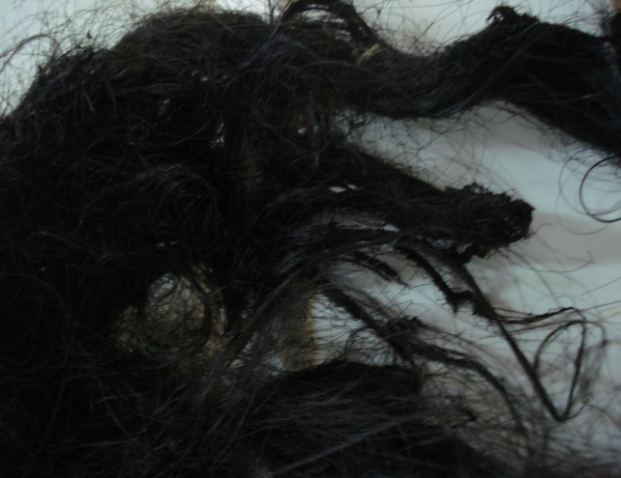
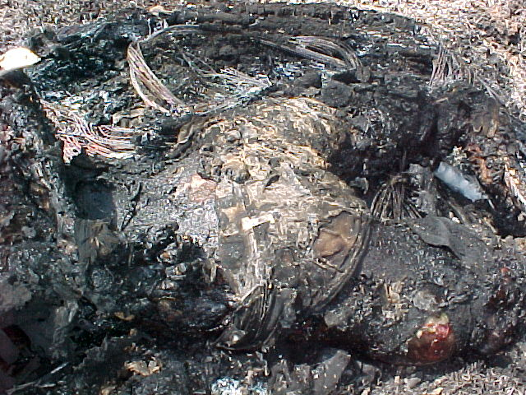
Appearance of dry burns
Singeing of hair
Coagulation of protein & charring

Slide 21
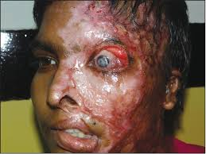
Appearance of dry burns
Heal with scar formation
Associated with contracture & disfigurement
Drip & splashes are absent (may be seen in petroleum product)

Slide 22
Appearance of dry burns
Reddening
to cremation

Slide 23
Appearance of dry burns
Mild burns - red/blisters
Moderate burns - Stiffened, yellow/ brown and leathery skin
Severe burns - soft tissues/ bones conversion of the bone to brittle greyish white splinters.

Slide 24
Appearance of dry burns
Skin discoloured due to smoke
Froth, pink stained at the mouth and nostrils - due to pulmonary oedema

Slide 25
Appearance of dry burns
Muscle contractures due to dehydration and protein denaturation
This is called 'pugilistic attitude‘

Slide 26
Examination of a burnt patient
History
Circumstances

Slide 27
Examination of a burnt patient
Distribution of burns
- diagrams
- photographs
Percentage of burns
Depth of burns

Slide 28
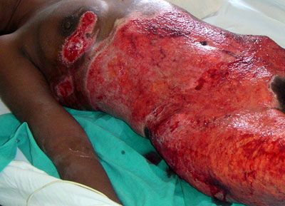
Injury description

Slide 29
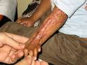
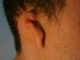
Case
30 year old person sustained accidental burn injuries from a burst boiler while working.
He has severe facial scarring, impairment of hearing, contractures at the elbow and wrist.
How do you categorize the hurt for MLR?

Slide 30
Category of hurt in burns
Grievous injury
Limb ‘b’ | Lose or impairment of vision
Limb ‘c’ | impairment of hearing
Limb ‘e’ | impairment of joints
Limb ‘f’ | disfigurement of head or face
Limb ‘i’ | Not attending ordinary work for 20 days

Slide 31
Category of hurt in burns
35% burns -Endangers life
50% burns - FIOCN
90% burns - Necessary fatal

Slide 32
Prognosis d/o
Degree of burns
Anatomical area involved
Depth of burns
Age of the victim
Treatment given

Slide 33
Corrosive Burns
Acids
Sulphuric, HCl, Nitric
Acetic, formic, oxalic, phenol
Alkali
NaOH, KOH,
Salts
KCN

Slide 34
Acid burns
Heat is generated when acid contacts the tissues
Acid coagulates protein
Coagulated protein acts as a barrier
Limit the penetration compared to alkali

Slide 35
Circumstances
Acid throwing
Accidental
Suicide
Rubber industry
Cleaning agents
Laboratory

Slide 36
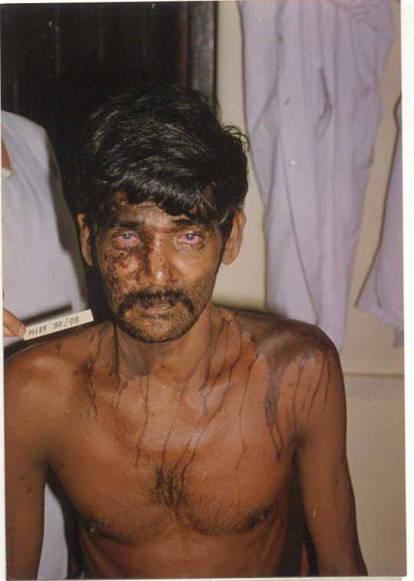
Features of acid burns on skin
Skin
drip marks
splash marks
deeper burns in clothed areas
severity uniform

Slide 37
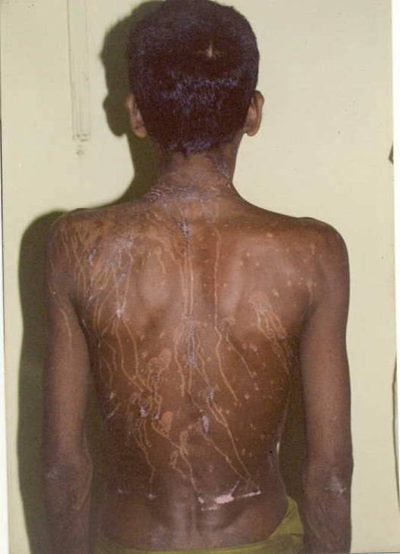
Features of acid burns on skin
Skin
heal with granulation tissue
scar formation with contracture
no singeing or blisters
colour d/o type of acid

Slide 38

Features of acid burns in ingestion
Ingestion
Spillage - on the exterior of the body
Lips are burnt and trickle
splash marks may run from the mouth down the chin, neck and chest
Shape of the container - Imprinted around the mouth

Slide 39
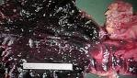
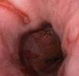
Features of acid burns in ingestion
Ingestion
Buccal mucosa, pharynx, larynx - eroded
Tongue - swollen/ shrivelled
Glottis - oedematous
Lower oesophagus and stomach – burns/perforations

Slide 40
Features of acid burns in ingestion
Respiratory passages - burns
pulmonary oedema and haemorrhage

Slide 41
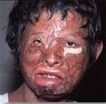
Case
A 48 year old person had given history of throwing of acid on his face. He has impairment of his vision on right eye.
What information do you collect at the time of history taking?
How do you determine the circumstances?
How do you categorize the hurt?

Slide 42
Category of hurt in corrosives
Grievous injury
Limb ‘b’ | Lose or impairment or vision
Limb ‘e’ | impairment of joints
Limb ‘f’ | disfigurement of head or face
Limb ‘i’ | Not attending ordinary work for 20 days

Slide 43
Causes of death in acid burns
Extensive burns
Severe pulmonary oedema and death
Asphyxia due to laryngeal oedema
Lung damage - bronchopneumonia

Slide 44
Causes of death in acid burns
Perforation of stomach and oesophagus- peritonitis and mediastinitis
Oesophageal damage causes strictures
Ingested corrosive can cause organ damage and death

Slide 45
Alkali burns
Saponification of fat
necrosis of proteins
Can continue even after the initial exposure ceases
Deep penetration of tissues
Leathery and slippery full thickness burns

Slide 46
Thank you

Slide 47
Medico-legal issues in death due to burns
Identity of the person

Slide 48
Medico-legal issues in death due to burns
Was the victim alive or dead at the time of burning
Cause of death
Time since death
Circumstances of injuries

Slide 49
Medico-legal issues in death due to burns
Interpretation of injuries
Are the burns ante mortem or post mortem
Heat artifacts
Injuries of intentional violence
Accidental trauma
Post mortem injuries
Lose of injuries

Slide 50
Case
A partially burnt body was found in a marshy land with injuries.
At the autopsy how you would determine whether these injuries are ante mortem or post mortem ?

Slide 51
Interpretation of injuries
Ante mortem burns
Presence of vital reaction ( broad red margins with erythema)
Presence of blisters ( red base, red margins, filled with fluid rich in proteins and polymorphs

Slide 52
Interpretation of injuries
PM blisters are
pale yellow

Slide 53
Interpretation of injuries
Cherry pink hypostasis

Slide 54
Interpretation of injuries
Soot mixed with mucous found attached to the trachea and bronchi or in lower respiratory passage

Slide 55
Interpretation of injuries
Soot particles in oesophagus and stomach mixed with saliva

Slide 56
Investigations help in injury interpretation
Cyanide in the blood
Co in the blood
Fat embolism in the lung
Histology -soot in the terminal bronchioles

Slide 57
Heat artifacts
Heat ruptures
on extensor surfaces mimic lacerations
Heat fractures
linear splitting of bone

Slide 58
Heat artifacts
Heat haematoma
collection of blood in the extra dural space
bilateral
chocolate brown
honey comb appearance

Slide 59
Heat artifacts
Contractures – gives pugilistic posture
Brain tissue in extra dural space
Accidental trauma by falling masonry
Skin ruptures due to pm handling
Loss of injuries

Slide 60
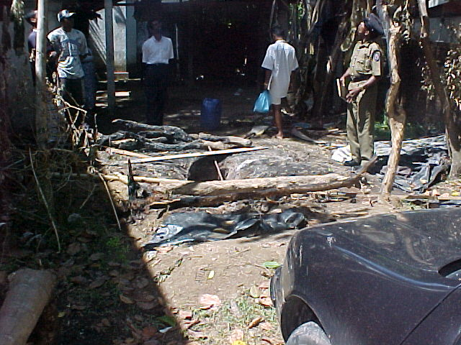
Medico-Legal investigation of death due to burns
History
date, time place
agent
reason for fire
circumstances
if suicide motivation

Slide 61
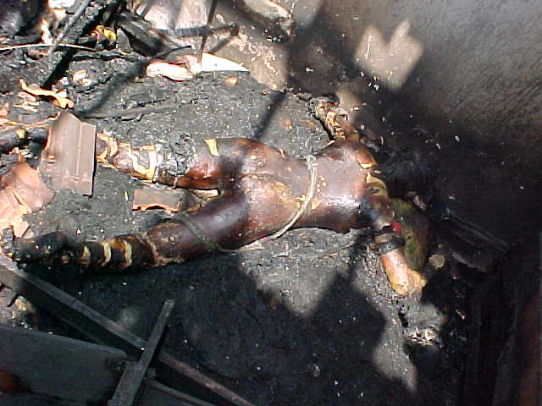
Medico-Legal investigation of death due to burns con’t.
Scene visit
place of maximum burns in the building
smell of gasoline
inflammable material

Slide 62
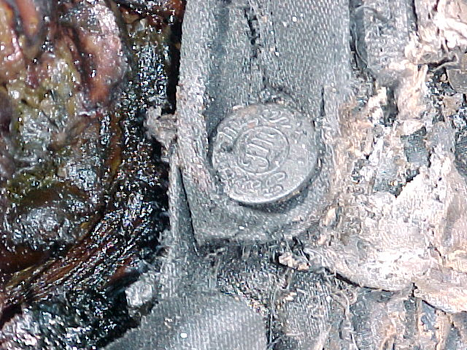
Medico-Legal investigation of death due to burns con’t.
Identification
Personal belongings
dental data
DNA

Slide 63
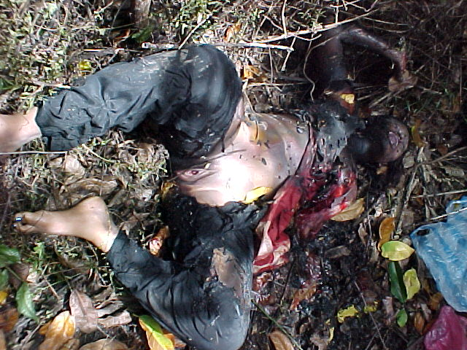
Medico-Legal investigation of death due to burns con’t.
Clothing
clothed
extent of burns
Smell of gasoline
partly clothed
naked

Slide 64
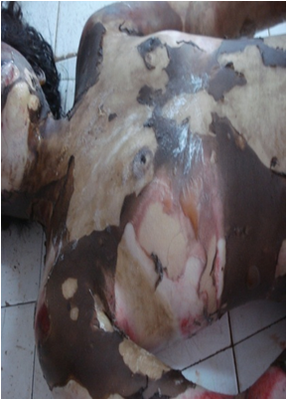
Medico-Legal investigation of death due to burns con’t.
external examination
Areas & extent of burns

Slide 65
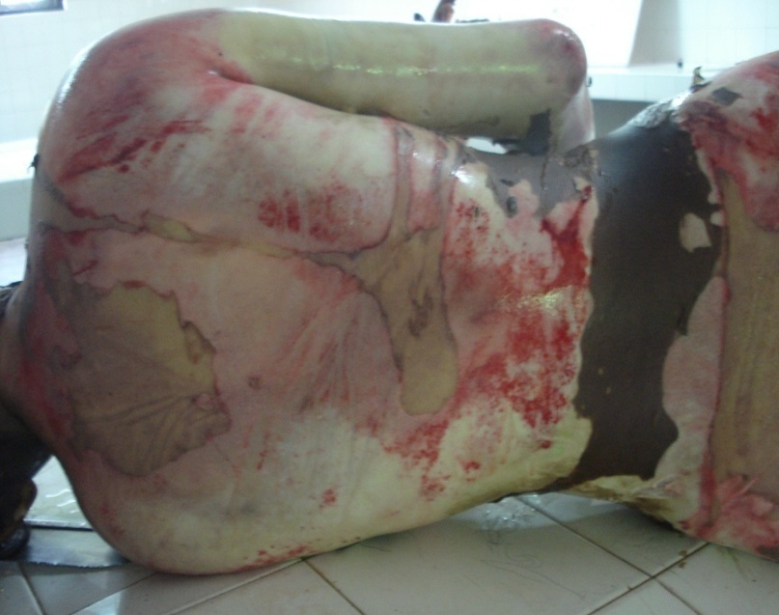
Medico-Legal investigation of death due to burns con’t.
Internal examination
Areas & extent of burns
Natural pathology

Slide 66
Medico-Legal investigation of death due to burns con’t.
Lab investigations
blood for Co , CN, alcohol, drugs
histopathology
stomach and contents

Slide 67
Causes of death in burns
Neurogenic shock - due to pain
Hypovolaemic shock
Co poisoning
Infection & septicaemia

Slide 68
Causes of death in burns
Asphyxia - by laryngeal oedema
Acute renal failure
Inhalation of toxic gases
Haematamesis - Curlings ulcers

Slide 69


Slide 70
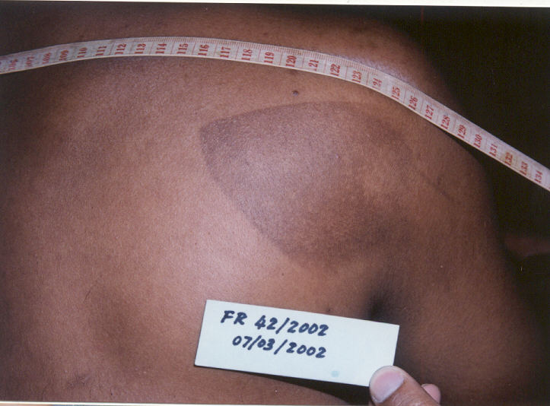

Slide 73
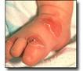
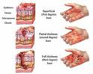
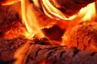
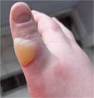
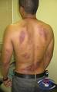
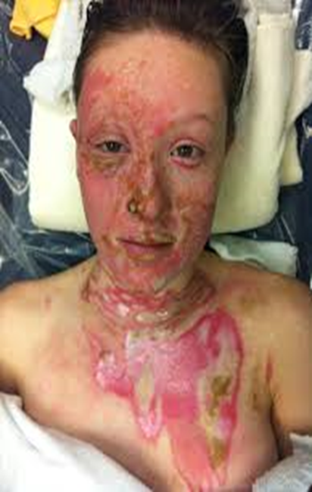
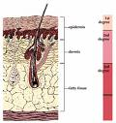
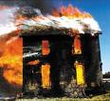
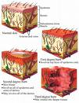
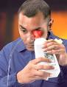
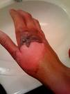
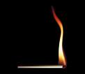
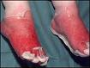
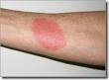
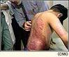
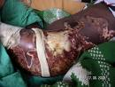
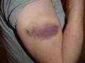

Slide 74
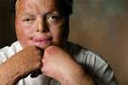












Slide 75













